Slide 1
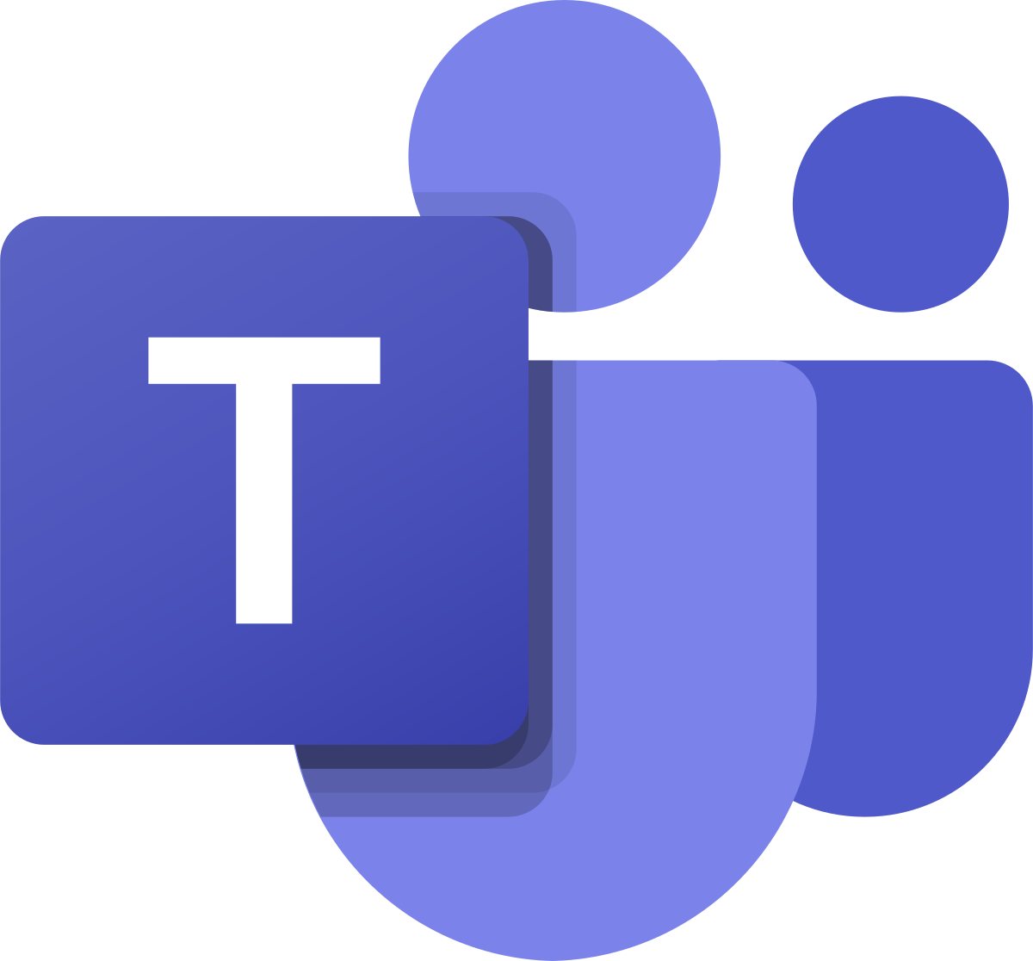
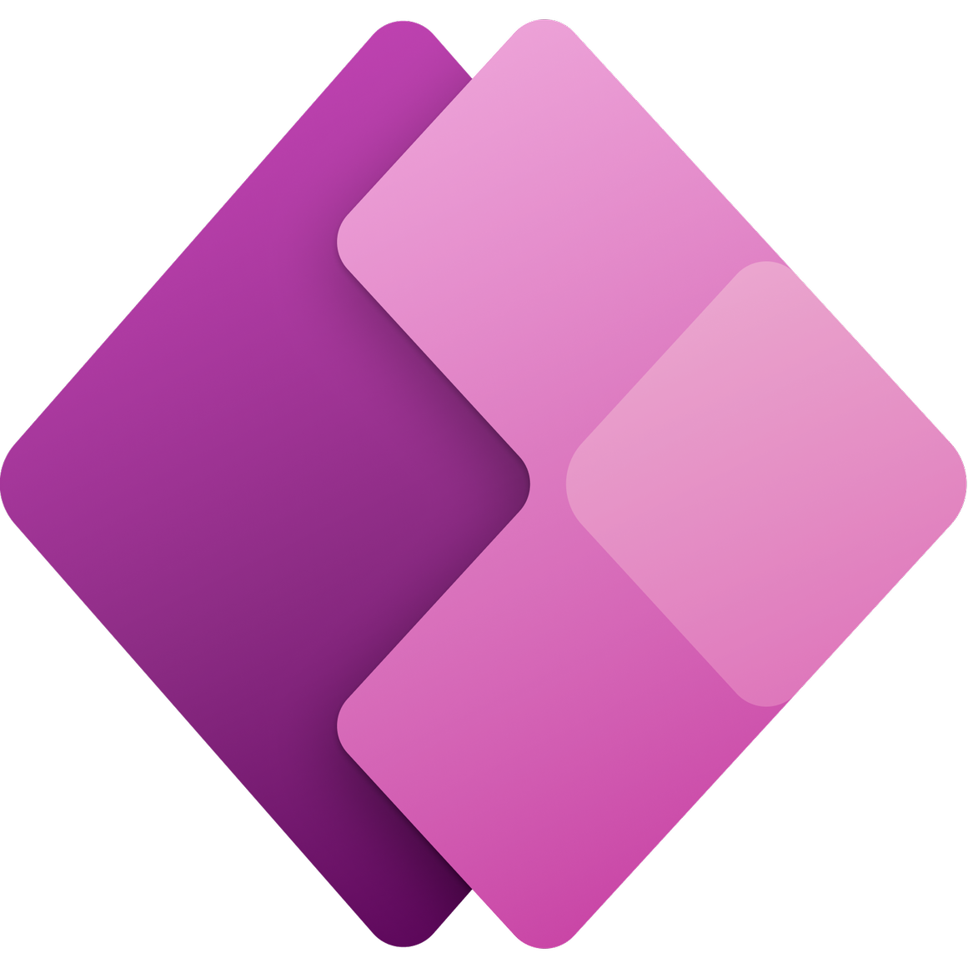


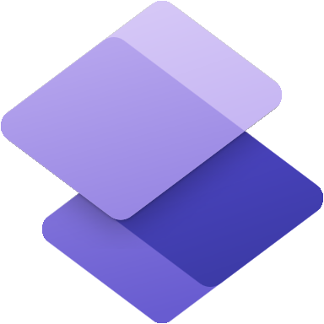










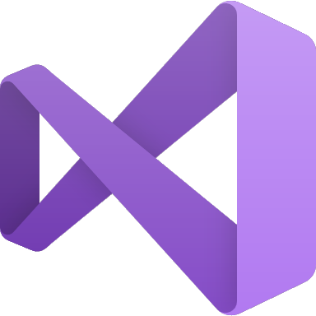
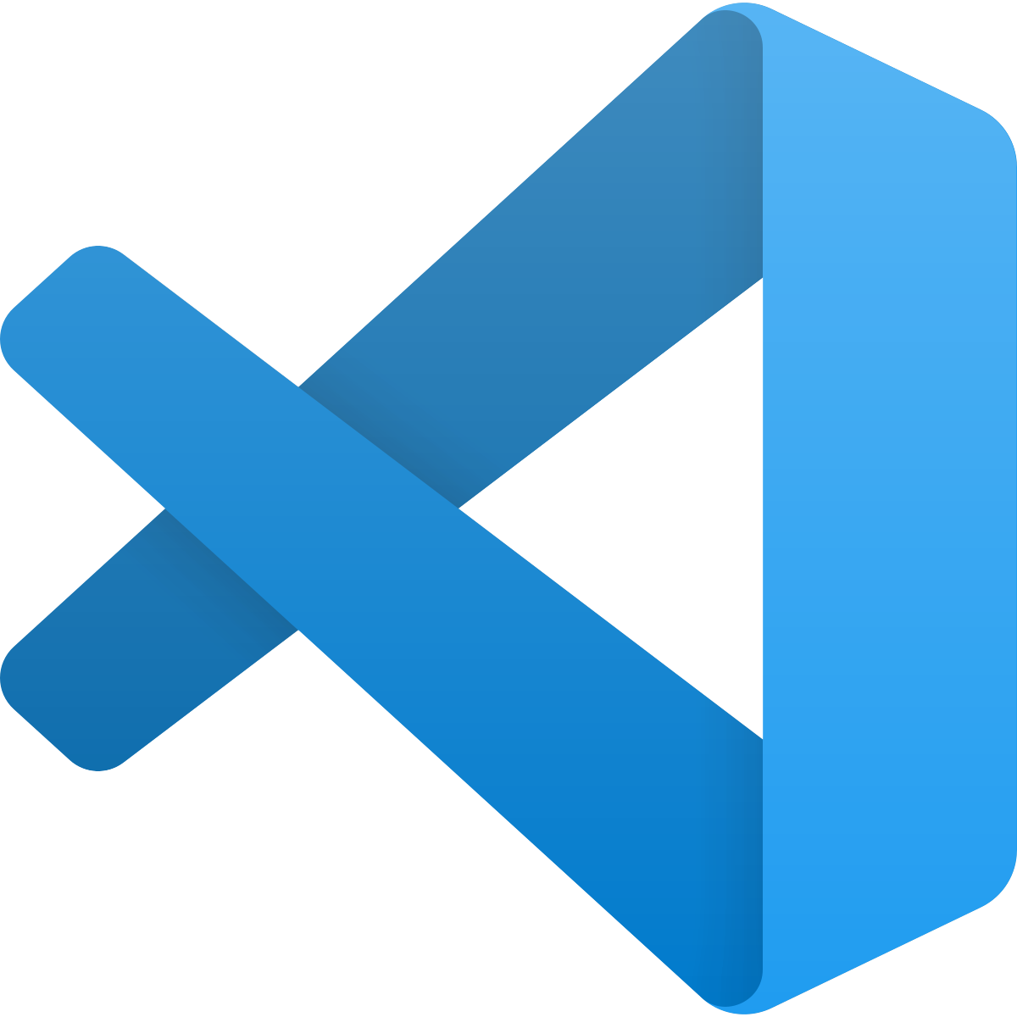
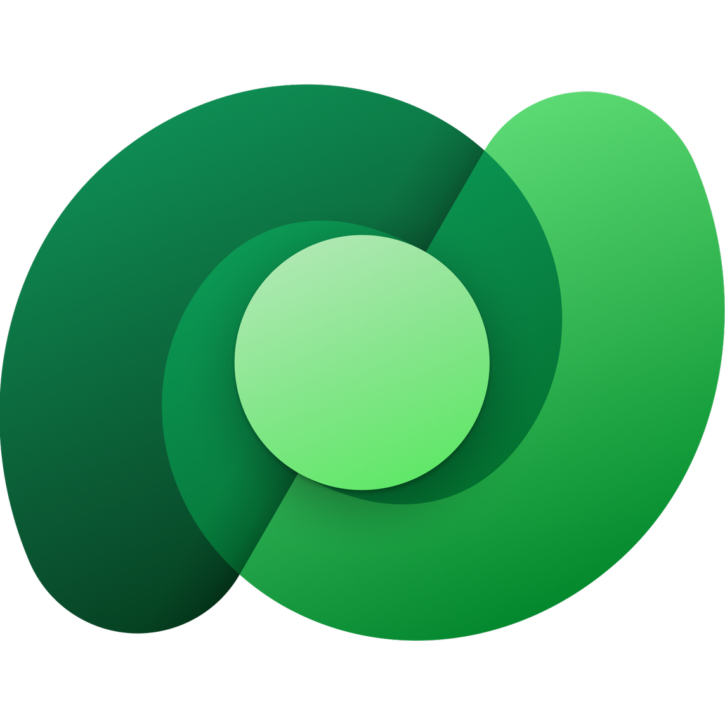




Every developer (Low-code)
Microsoft Teams
Power Apps
Application development
Power Automate
Workflow automation
Power BI
Business analytics
Power Pages
Website development
Power Virtual Agents
Intelligent virtual agents
Azure services
Pro developer (Code-first)
GitHub
Analysis
Services
API Management
Function
Apps
Kubernetes
Services
Logic
Apps
Cognitive Services
Bot
Services
Azure / Office
Data Services
Visual
Studio
Visual Studio
Code
Azure
DevOps
Dataverse
Microsoft
Graph
SQL
Database
SQL Data Warehouse
Cosmos
Database
Fusion Team (All devs and business)

Slide 2
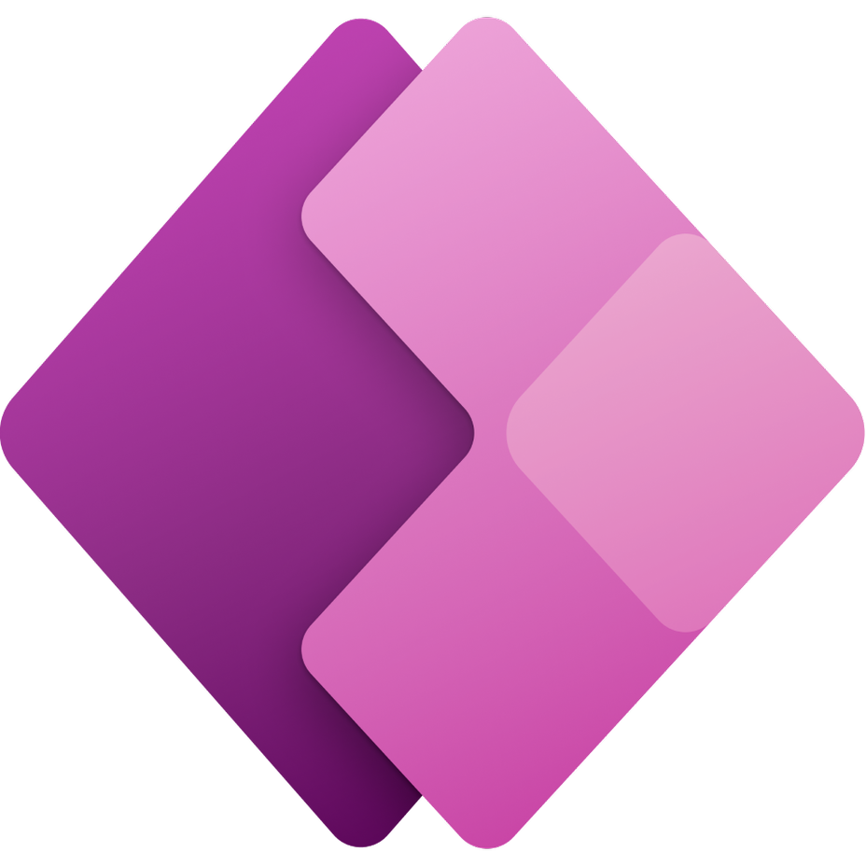



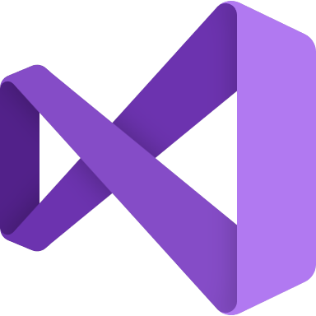

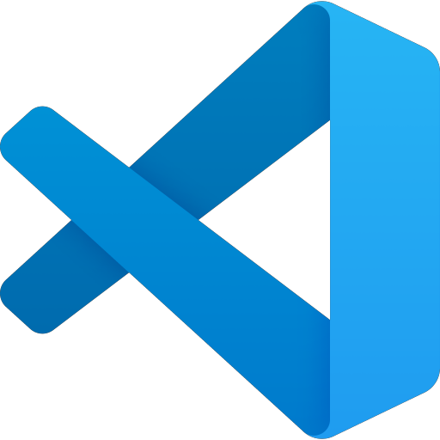


Fusion Team Development
Low-code and pro-dev application development extensibility with Power Apps + Azure
Power Apps
GitHub
Azure services
APIs
Power Automate
Visual Studio
Power BI
Visual Studio Code
Microsoft Azure
Power Pages
Power Virtual Agents
Code-first developers
Citizen developers
Notes:
Professional developers can provide a secure, scalable foundation for low-code apps built by employees from all departments.
Today, developers can create applications using their favorite tools.
They can use multiple Azure services to rapidly create applications and building blocks that empower even more developers in your organization.
Microsoft provides the only comprehensive DevOps solution that spans from development to project management to deployment to operations.
Azure offers a practical approach to automation at every step of the DevOps lifecycle that enables companies to focus their efforts on creating business value.
To scale innovation, organizations need to focus first on packaging and shipping their unique business value as composable services – this way, partners and employees can participate in shared value generation easily and efficiently and tap into domain experts – those closest to the business problem and bring them powerful, easy to use tools that are low code or no code so they can create apps themselves.
And that’s what the Power Platform – spanning Power Apps, Power Automate and Power BI – does.
It enables anyone in an organization to start building an intelligent app or workflow where none exists.
It is the only solution of its kind – bringing together no-code/low code app development, process automation, and self-service analytics into a single, comprehensive platform.
Business / developer / IT people
Fusion teams – citizen developers as a part of business digitally transforming their processes

